Slide 1




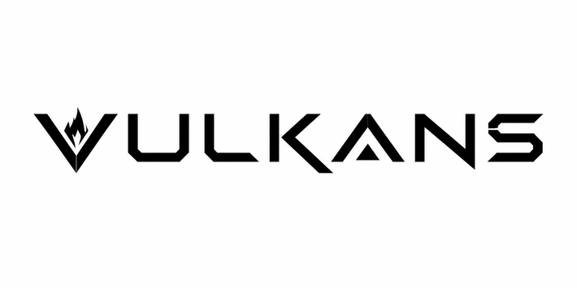
SMART INDIA HACKATHON 2026
  Problem Statement ID – 26151
  Problem Statement Title – Dark-web Threat Actor De-anonymization
  Theme – Blockchain & Cybersecurity
  PS Category – Software
  Team ID – ____

Slide 2

DEIMOS
Dark-web Entity Identification, Mapping & OSINT System
Vulkans
  01 — Problem
    The dark web lets threat actors hide behind Tor services, making attribution difficult.
    Enables drug & arms trafficking, stolen data sales, hacking services, money laundering and terror financing.
02 — Our Solution
AI-powered OSINT platform linking anonymous dark-web actors to real-world entities.
    Correlates Tor-service vulnerabilities with clearnet infrastructure
    Links aliases, PGP keys & wallets in a unified graph
    Multi-model AI for behavioural & cross-platform persona matching
03 — What Makes DEIMOS Different
    Clearnet alias discovery via dedicated X search
    Explainable identity graphs with confidence scores
    Adaptive persona tracking across rebrands
    Human-in-the-loop attribution validation
    Integrated dark-web search on critical sites
Bennett University
2
Notes:
2

Slide 3

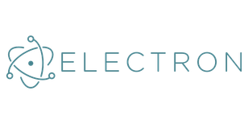




TECHNICAL APPROACH
Vulkans
Technology Stack
  Frontend: Electron | React | TypeScript
  Core: Go
  AI: Python | FastAPI | PyTorch | Transformers | LLMs
  Data: Neo4j | PostgreSQL | Elasticsearch
  Collection: Tor Proxy | OSINT APIs | Crawlers
  Deployment: Docker | VPS | NVIDIA GPU (optional)
Implementation Methodology
Dark Web & Clearnet Sources
Secure Automated Collection
Profile Construction
Multi-Model AI analysis
Knowledge Graph Construction
Investigation Dashboard, Alerts & Reports
Bennett University
3
Notes:
3

Slide 4
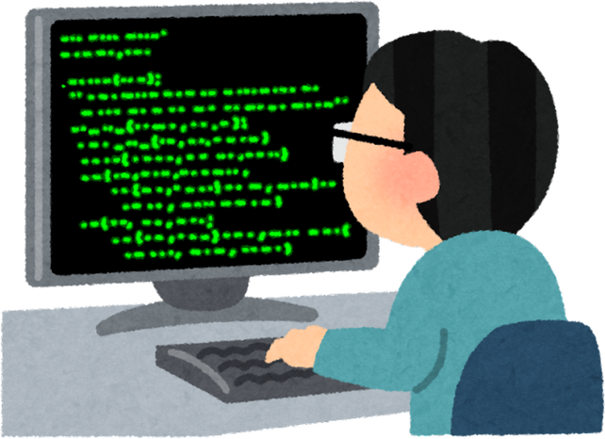

FEASIBILITY AND VIABILITY
Vulkans
Feasibility
  Built on mature, open-source technologies (Electron, Go, Python, Neo4j, AI models)
  Modular architecture supports phased development and future scaling
  Automated collection + AI-assisted analysis cuts manual investigation effort
  Deployable on standard servers, with optional GPU acceleration
Challenges → Mitigation
Challenge / Risk | Mitigation Strategy
Unstable / inaccessible dark-web sources | Monitoring, retries & source archiving
False links & deceptive identities | Multi-source verification + confidence scoring
AI errors or hallucinations | Evidence grounding + cross-validation
Legal, ethical & privacy concerns | RBAC + lawful-source policy + controlled retention
Sensitive data & system security | Encryption, isolation + audit logs
Viability
Prototype → Secure, Organization-Level Threat-Intelligence Platform
Bennett University
4
Notes:
4

Slide 5
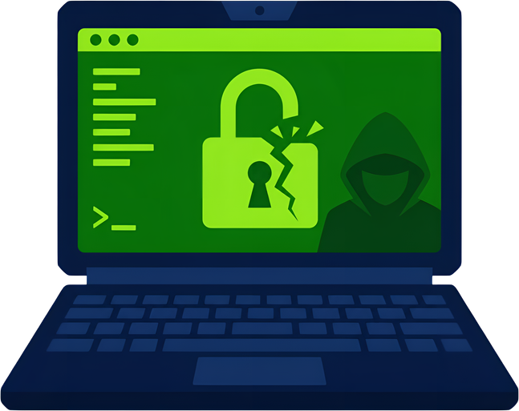

IMPACT AND BENEFITS
Vulkans
Potential Impact
  Faster Attribution: Identify and track threat actors faster.
  Actionable Intelligence: Converts scattered data into evidence-linked intelligence.
  Higher Accuracy: AI correlation + confidence scoring improve investigations.
  Early Threat Detection: Detects cybercrime, illicit trade, fraud & terror-financing networks earlier.
Key Benefits
  Social: Citizen & organizational protection
  Economic: Lower losses & investigation costs
  Operational: Faster, data-driven analyst decisions
  National Security: Stronger threat monitoring & intelligence sharing
  Environmental: Efficient, scalable processing
Bennett University
5
Notes:
5

Slide 6

RESEARCH AND REFERENCES
Vulkans
Research Foundations
  Europol IOCTA — Research on dark-web-enabled cybercrime & emerging threats
  Tor Project Specifications — Onion-service architecture & protocols
  VeriDark – NeurIPS 2022 — Benchmark for dark-web authorship verification
  DarkBERT – ACL 2023 — Domain-specific language model trained on dark-web data
  MITRE ATT&CK — Knowledge base for threat actors, tactics & techniques
  Neo4j Graph Technology — Reference for entity relationships & network analysis
Bennett University
6
Notes:
6

